Slide 1
10-8
Spheres
Warm Up
Lesson Presentation
Lesson Quiz
Holt Geometry

Slide 2
Warm Up
Find each measurement.
1. the radius of circle M if the diameter is 25 cm
2. the circumference of circle X if the radius is 42.5 in.
3. the area of circle T if the diameter is 26 ft
4. the circumference of circle N if the area is 625π cm²
12.5 cm
85π in.
169π ft²
50π cm

Slide 3
Objectives
Learn and apply the formula for the volume of a sphere.
Learn and apply the formula for the surface area of a sphere.

Slide 4
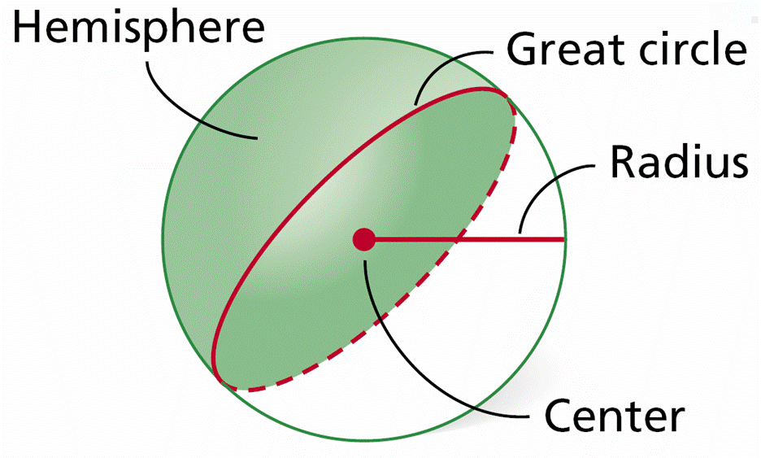
A sphere is a three dimensional circle.
A radius of a sphere connects the center of the sphere to any point on the sphere.

Slide 6
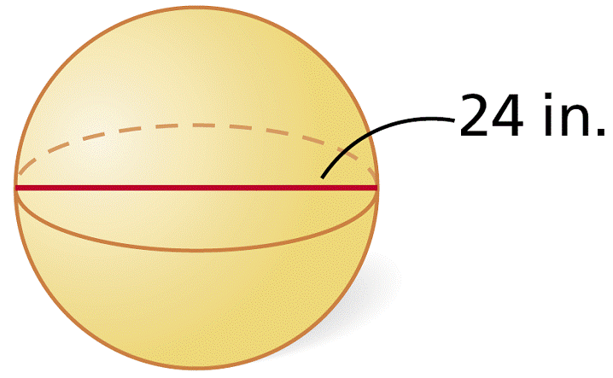
Example 1A: Finding Volumes of Spheres
Find the volume of the sphere. Give your answer in terms of π.
Volume of a sphere.
= 2304π in³
Simplify.

Slide 7
Example 1B: Finding Volumes of Spheres
Find the diameter of a sphere with volume 36,000π cm³.
Volume of a sphere.
Substitute 36,000π for V.
27,000 = r³
r = 30
Take the cube root of both sides.
d = 60 cm
d = 2r

Slide 8
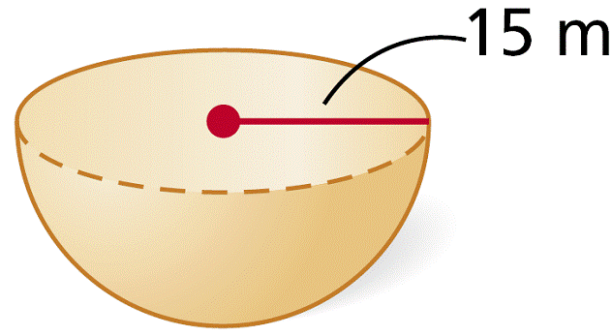
Example 1C: Finding Volumes of Spheres
Find the volume of the hemisphere.
Volume of a hemisphere
Substitute 15 for r.
= 2250π m³
Simplify.

Slide 9
Check It Out! Example 1
Find the radius of a sphere with volume 2304π ft³.
Volume of a sphere
Substitute for V.
r = 12 ft
Simplify.

Slide 10
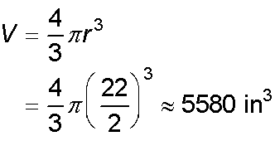
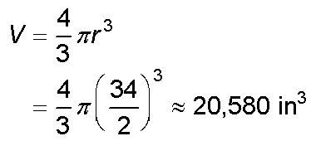
Example 2: Sports Application
A sporting goods store sells exercise balls in two sizes, standard (22-in. diameter) and jumbo (34-in. diameter). How many times as great is the volume of a jumbo ball as the volume of a standard ball?
jumbo ball:
standard ball:
A jumbo ball is about 3.7 times as great in volume as a standard ball.

Slide 12
Example 3A: Finding Surface Area of Spheres
Find the surface area of a sphere with diameter 76 cm. Give your answers in terms of π.
S = 4πr²
Surface area of a sphere
S = 4π(38)² = 5776π cm²

Slide 13
Example 3B: Finding Surface Area of Spheres
Find the volume of a sphere with surface area 324π in². Give your answers in terms of π.
S = 4πr²
Surface area of a sphere
324π = 4πr²
Substitute 324π for S.
r = 9
Solve for r.
Substitute 9 for r.
The volume of the sphere is 972π in³.

Slide 14
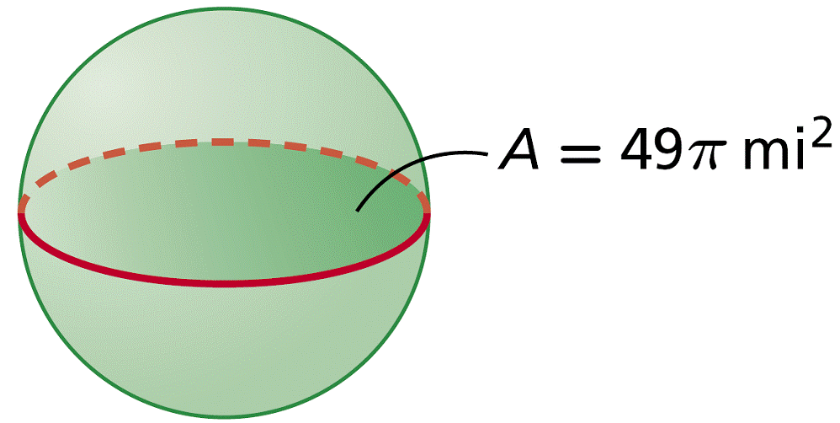
Example 3C: Finding Surface Area of Spheres
Find the surface area of a sphere with a great circle that has an area of 49π mi².
A = πr²
Area of a circle
49π = πr²
Substitute 49π for A.
r = 7
Solve for r.
S = 4πr²
= 4π(7)² = 196π mi²
Substitute 7 for r.

Slide 15
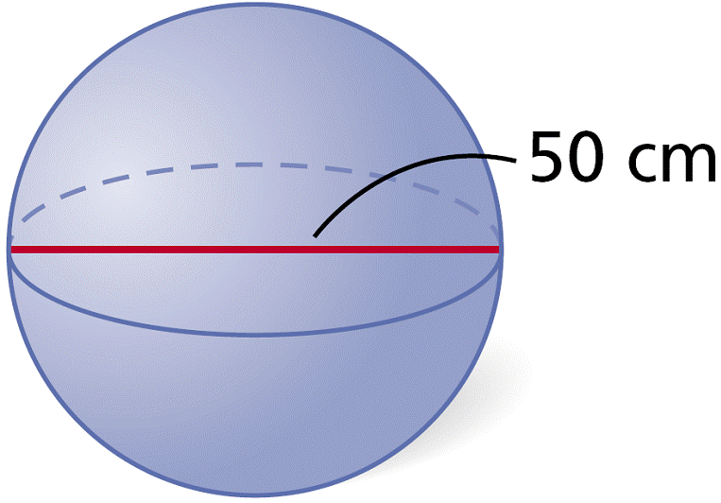
Check It Out! Example 3
Find the surface area of the sphere.
S = 4πr²
Surface area of a sphere
S = 4π(25)²
Substitute 25 for r.
S = 2500π cm²

Slide 16
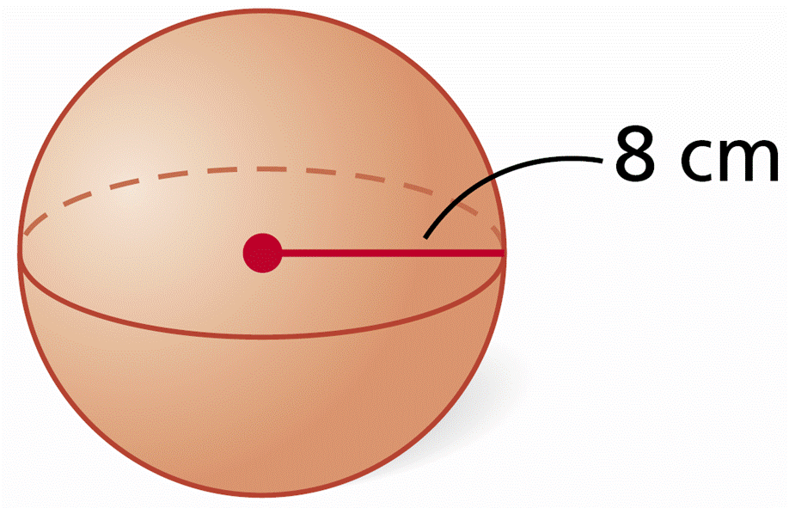
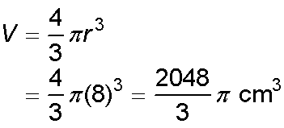
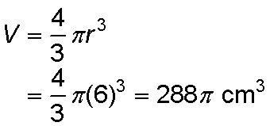
Example 4: Exploring Effects of Changing Dimensions
The radius of the sphere is multiplied by . Describe the effect on the volume.
original dimensions:
radius multiplied by :
Notice that . If the radius is multiplied by , the volume is multiplied by , or .

Slide 17
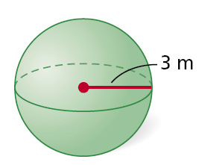
Check It Out! Example 4
The radius of the sphere is divided by 3. Describe the effect on the surface area.
original dimensions:
dimensions divided by 3:
S = 4πr²
S = 4πr²
= 4π(3)² = 36π m³
= 4π(1)² = 4π m³
The surface area is divided by 9.

Slide 18
Homework:
Page 87, #20-21
Page, 92, #50

